Slide 1
Masked Autoencoders Are Scalable Vision Learners
2021250020 한정찬

Slide 2
01
Introduction

Slide 3
Masked autoencoder
NLP
Autoregressive modeling of GPT
Masked autoencoding of BERT
Remove a portion of data,
learn to predict
Computer Vision
Masked autoencoder
don’t work well
What’s the difference ??

Slide 4
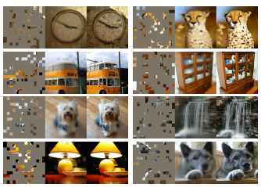
Language vs Image
Architectures
Attention VS CNN (solved by ViT)
Information density
Language > Image (하나의 sematic 정보)
Spatial redundancy
Decoder’s role
predict words vs. pixels

Slide 5
02
Methodology

Slide 6
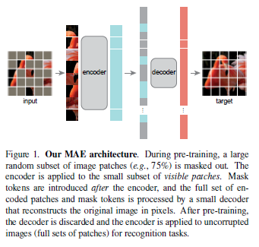
Our MAE
High Masking ratio
reduce redundancy
Asymmetric encoder-decoder
Encoder – only patches without masking
Decoder – latent representation + masked
Reduce computation

Slide 7
Our MAE
Masking
MAE encoder
Divide image into non-overlapping patches
Random sampling with high masking ratio
ViT but applied only on unmasked patches (25%)
Less computation, memory

Slide 8
Our MAE
MAE decoder
Reconstruction
Input: encoded patches + masked tokens
Add positional embeddings (info about location)
MAE decoder is only used during pre-training reconstruction task
Independent of encoder design
Predict pixel values of masked patches
Loss function computes MSE only on masked patches(like BERT)
Notes:
The MAE decoder is only used during pre-training to perform the image reconstruction task (only the encoder is used to produce image representations for recognition).

Slide 9
03
Experiments

Slide 10
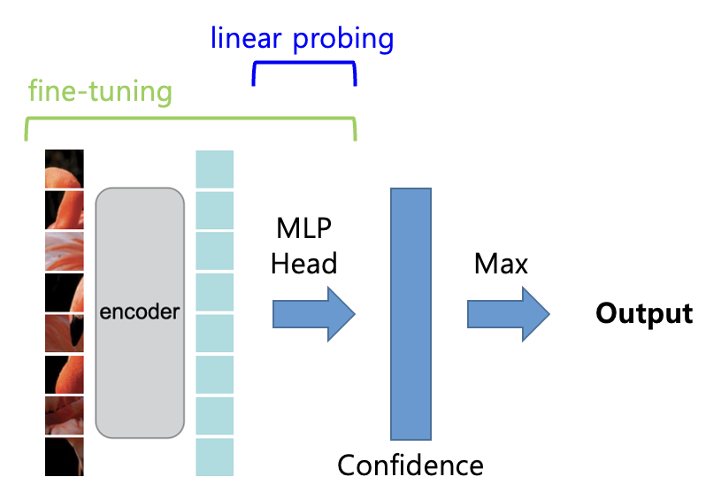
ImageNet Experiments
Self-supervised pre-training on ImageNet-1K
Then evaluate
Fine-tuning
Linear probing
Baseline: ViT-Large
Notes:
classification으로 downstream task 학습 때 encoder를 trainable하게 두느냐, freeze하여 고정하느냐
fine-tuning은 사전 학습된 인코더와 MLP 헤드를 모두 학습하는 것이고,
linear probing은 사전 학습된 인코더의 웨이트는 고정하고 MLP 헤드만 학습하는 것이다.

Slide 11
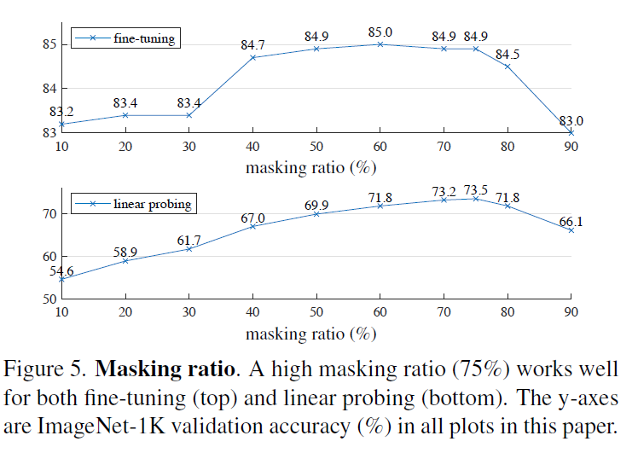
Masking ratio
High Masking ratio
75% is good for both
Contrast behavior with BERT (typically 15%)

Slide 12
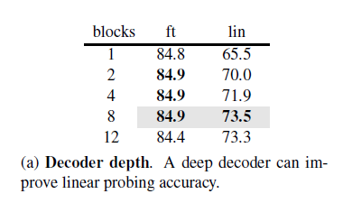
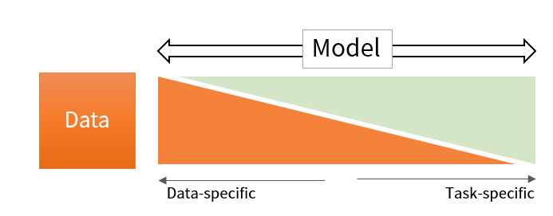
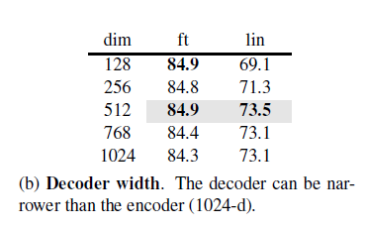
Decoder Design
sufficiently deep decoder is important for linear probing
gap between a pixel reconstruction task and a recognition task

Slide 13
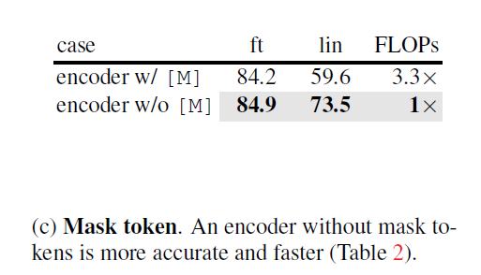
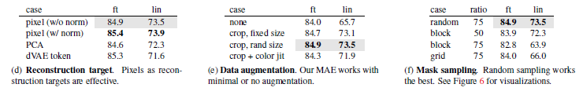
Others
Reduce computation

Slide 14
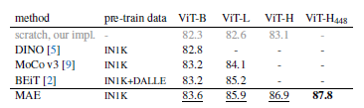
Comparisons with previous results

Slide 15
Conclusion
Language -> BERT
Vision -> MAE
Different domain, same approach, meaningful result

Slide 16
Thanks!

